Slide 1

Stents
A review of
“Do Stents Last Forever?

Slide 2
How Long Does A Stent Last?
Most stents are made of a metal such as titanium and will easily last our lifetime
The question therefore should be instead: how long will the treatment help?
The truth about stents:
  10-15% of stents fail
  >40% of patients with a stent will need another procedure
  Expensive medications are needed

Slide 3
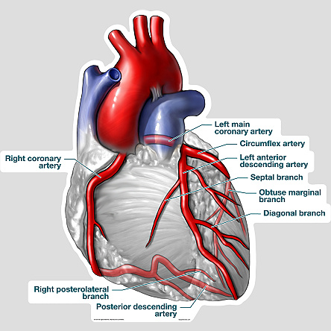

Slide 4
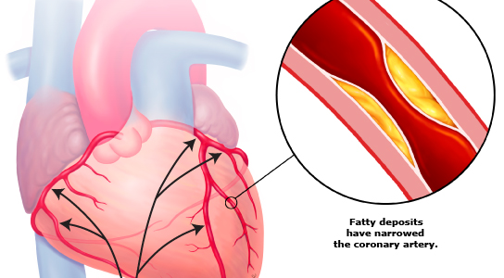
Coronary Artery Disease

Slide 5
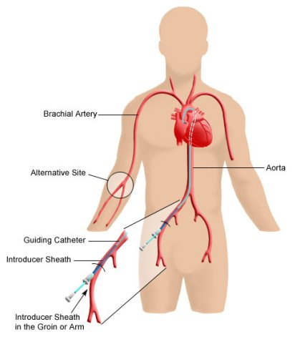
Cardiac Cath

Slide 6
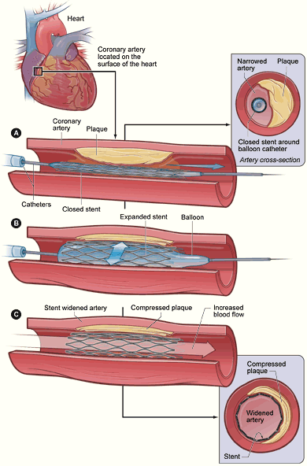
Stenting

Slide 7
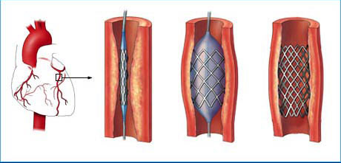
Stenting

Slide 8
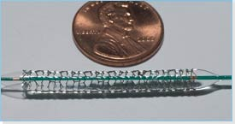
Stent

Slide 9
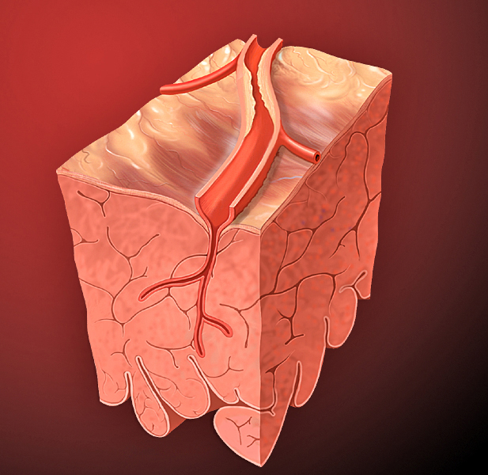
“How Long Does a Stent Last?”
Not everyone needs one!
Incomplete revascularization
Local Damage
Doesn’t work well in small arteries
Recurrent Blockage
Thrombosis
May obstruct side branches:

Slide 10
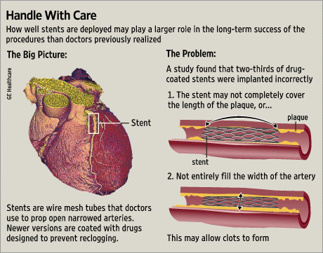

Slide 11
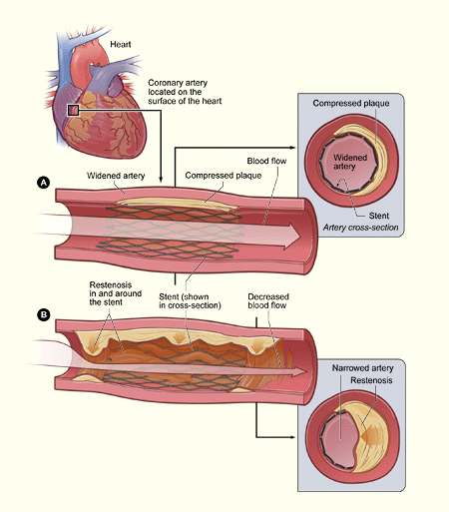

Slide 12
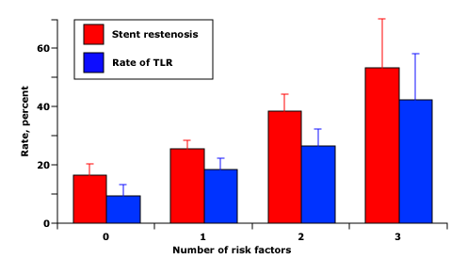
Stent Failure Rates

Slide 13
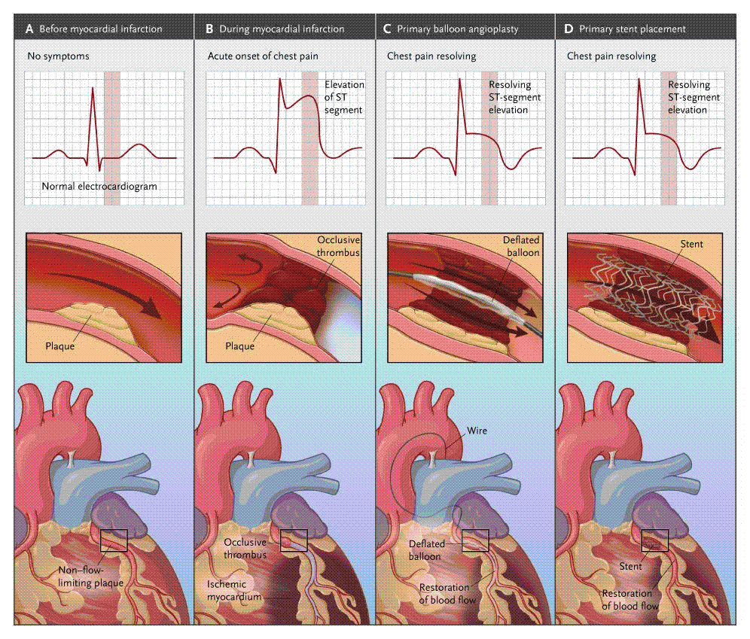
Lifesaver: Stenting for STEMI

Slide 14
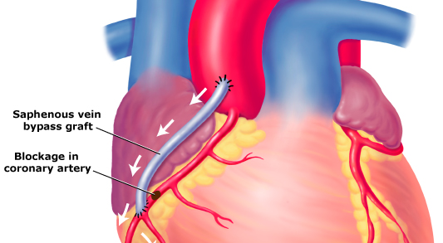
CABG (“Cabbage”)

Slide 15
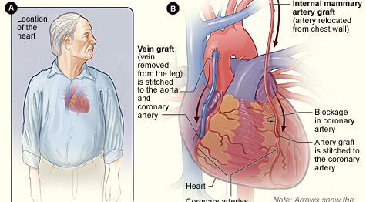
CABG with a Vein & LIMA

Slide 16
How long does a CABG last
95% success rate
Treatment of choice in patients with extensive CAD
Works only well if complications are avoided

Slide 17
Consider Your Options:
Optimal Medical Therapy is more effective for patients with stable Coronary Artery Disease, at a fraction of the cost. Interventions should be limited to those at risk (85% of PCI may not be indicated):
    "Stable coronary artery disease accounted for 85% of all stenting in the United States at the time of the Clinical Outcomes Utilizing Revascularization and Aggressive Drug Evaluation (COURAGE) trial.”
    CABG remains the standard of care and is by far the more cost-effective in comparison with stents (w/i one year!).
When is a bypass operation the best option?
When you have a chance, read this article first (click here)
Remember: neither Stenting nor CABG treat Atherosclerosis, the cause of CAD.
However, of the two procedures, PCI is more like the quick fix, CABG the long distance runner.
Calculate what might be best for you.

Slide 18
Rhythm
The question:
Abnormal EKG with RBBB, skippy heart rhythm and an occasional extra hard beat following the missed beat. These have presented for years, occasional light headed when crouching and standing. Low heart rate 50 lower at night when asleep. Had tests done 4 years ago for same symptoms, normal.

Slide 19
Answer
You need to see your doctor!
Different components:
  RBBB
  Palpitations
  Bradycardia
  Dizziness

Slide 20
RBBB
Right bundle branch block (RBBB) is very common
If you do not have other heart disease, or other blocks in your electrical conduction system, no treatment is necessary.
      It may be an indicator of other heart disease
Other complications of RBBB:
  Arrhythmia
  Slow heart rate (bradycardia)
  Cardiac arrest
  Sudden cardiac death

Slide 21
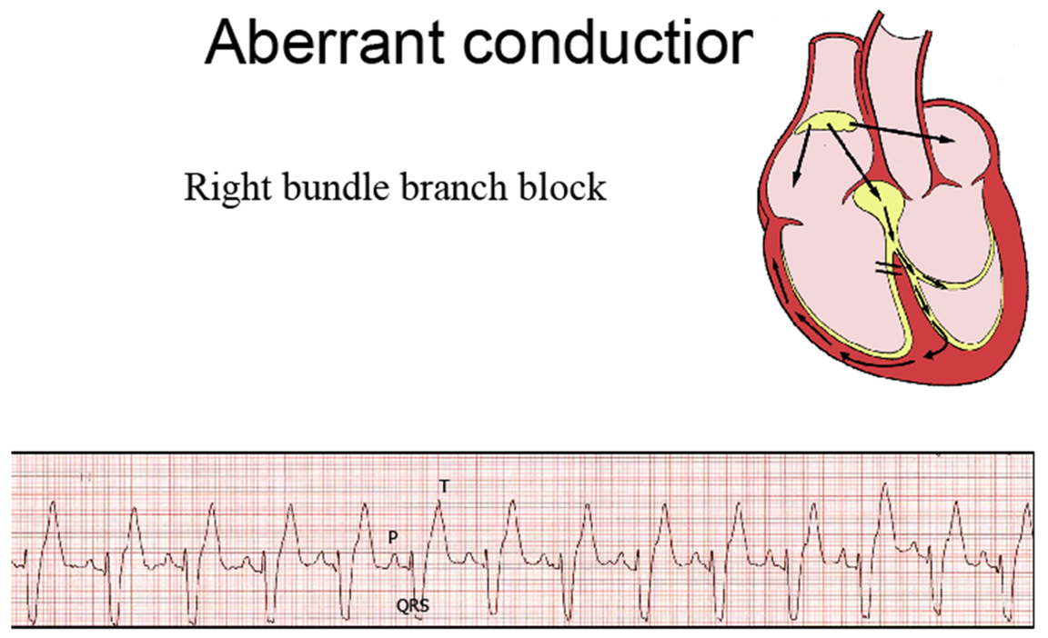
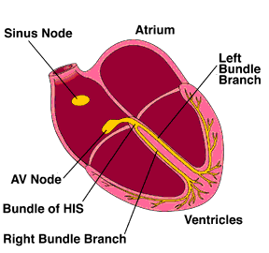
Your Heart’s Wiring

Slide 22
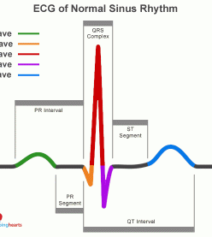
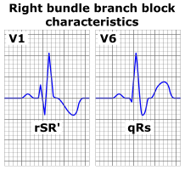
Normal ECG & RBBB

Slide 23
RBBB Causes
A congenital heart defect
A previous heart attack
A previous infection of your heart
High blood pressure
Scar tissue after heart surgery
A blood clot in the lungs

Slide 24
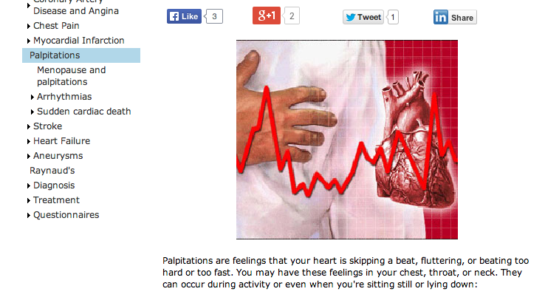
Palpitations

Slide 25
Palpitations
The following conditions make you more likely to have an abnormal heart rhythm:
Significant risk factors for heart disease
An abnormal heart valve
An electrolyte abnormality in your blood -- for example, a low potassium level

Slide 26
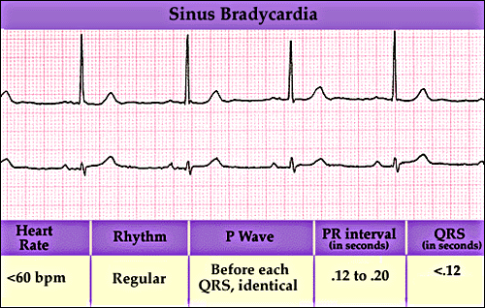
Slow Heart Rate and Light headedness
Bradycardia may be caused by a blockage somewhere along the heart’s electrical pathway:
Light headedness: many potential causes

Slide 27
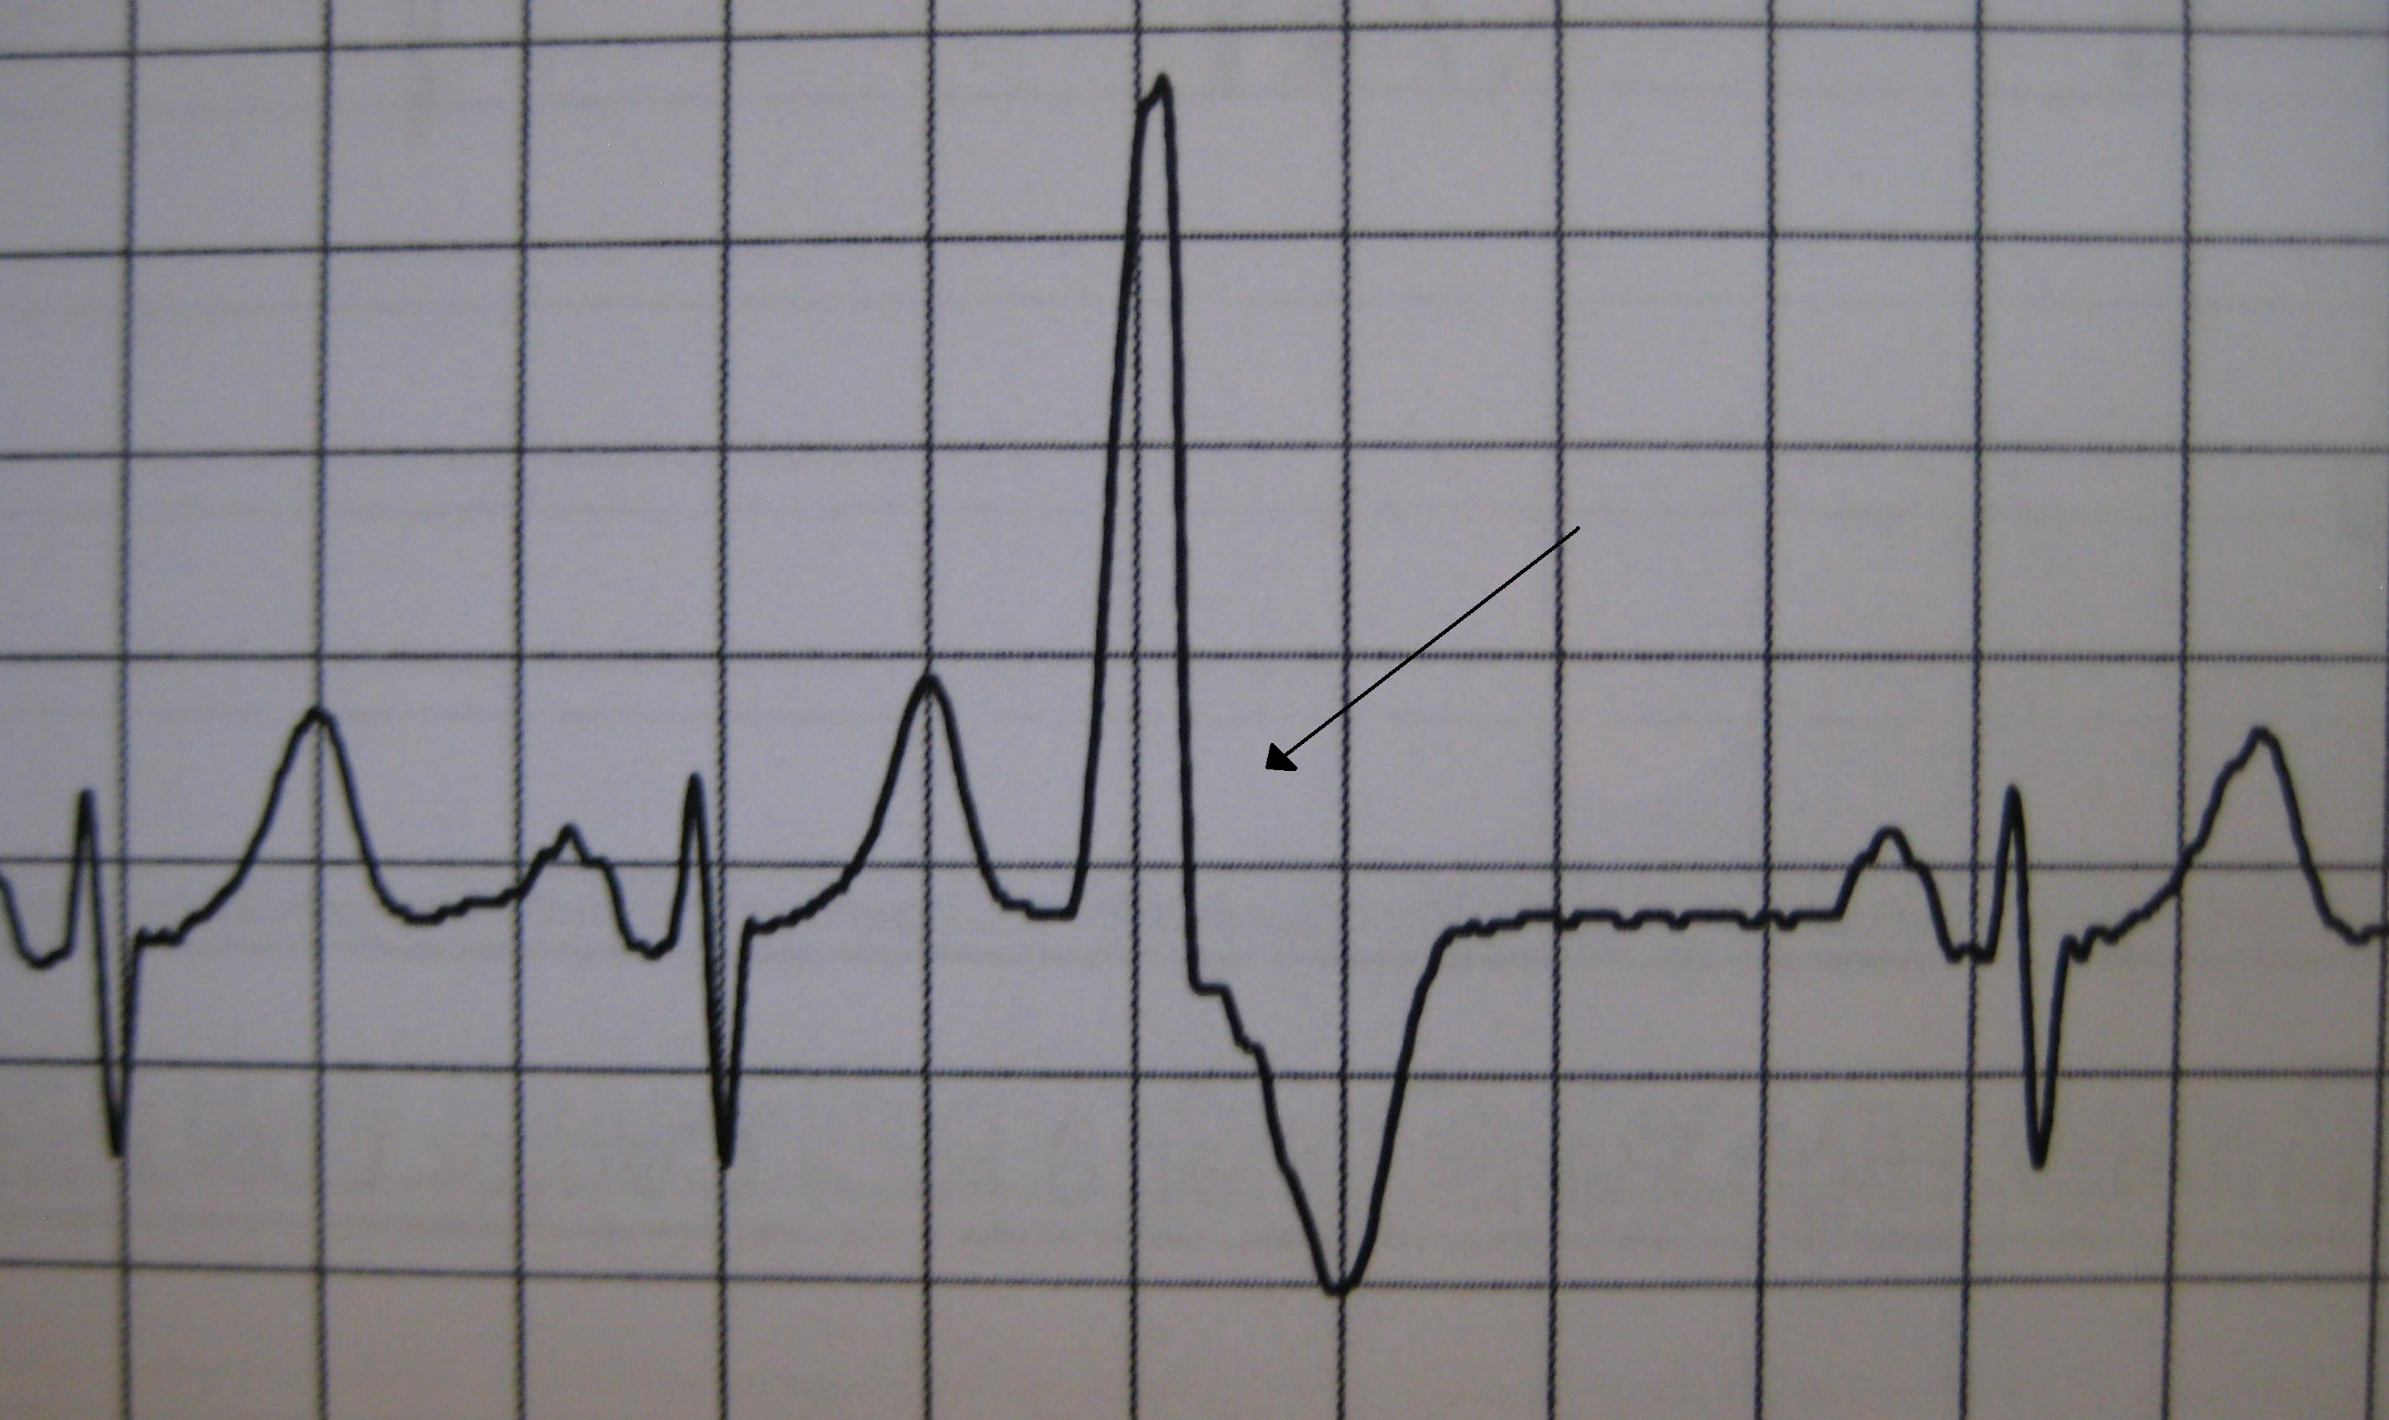
Extra Beats

Slide 28
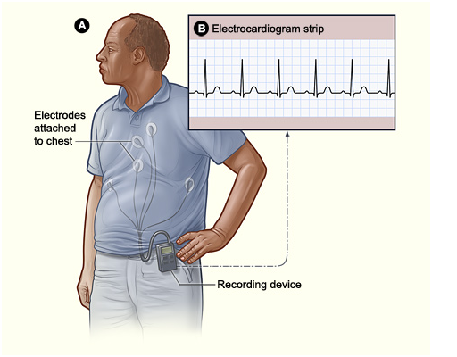
Diagnostic Tests: Monitor

Slide 29
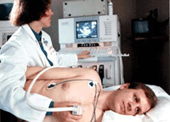
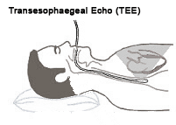
Echocardiogram
TEE

Slide 30
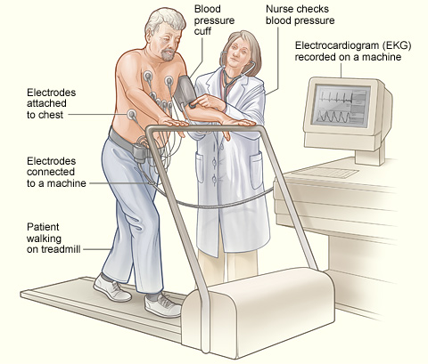
Stress ECHO

Slide 31
Catherization

Slide 32
Treatment
Eliminate caffeine, tobacco and alcohol
Your symptoms are suggestive of a problem with your heart that needs to be evaluated further
If your arrhythmias (RBBB, Bradycardia and extra beats) are causing light headedness, you may need specific treatment

